Slide 1
AI in Fashion Design Practice
A Review of Designer Adaptation to Artificial Intelligence
Dulashi Kongahawaththa
Department of Textile and Apparel Engineering
University of Moratuwa
Dr. Sumith Gopura
Department of Textile and Apparel Engineering
University of Moratuwa
Dr. Madeline Taylor
School of Design
Queensland University of Technology

Slide 2
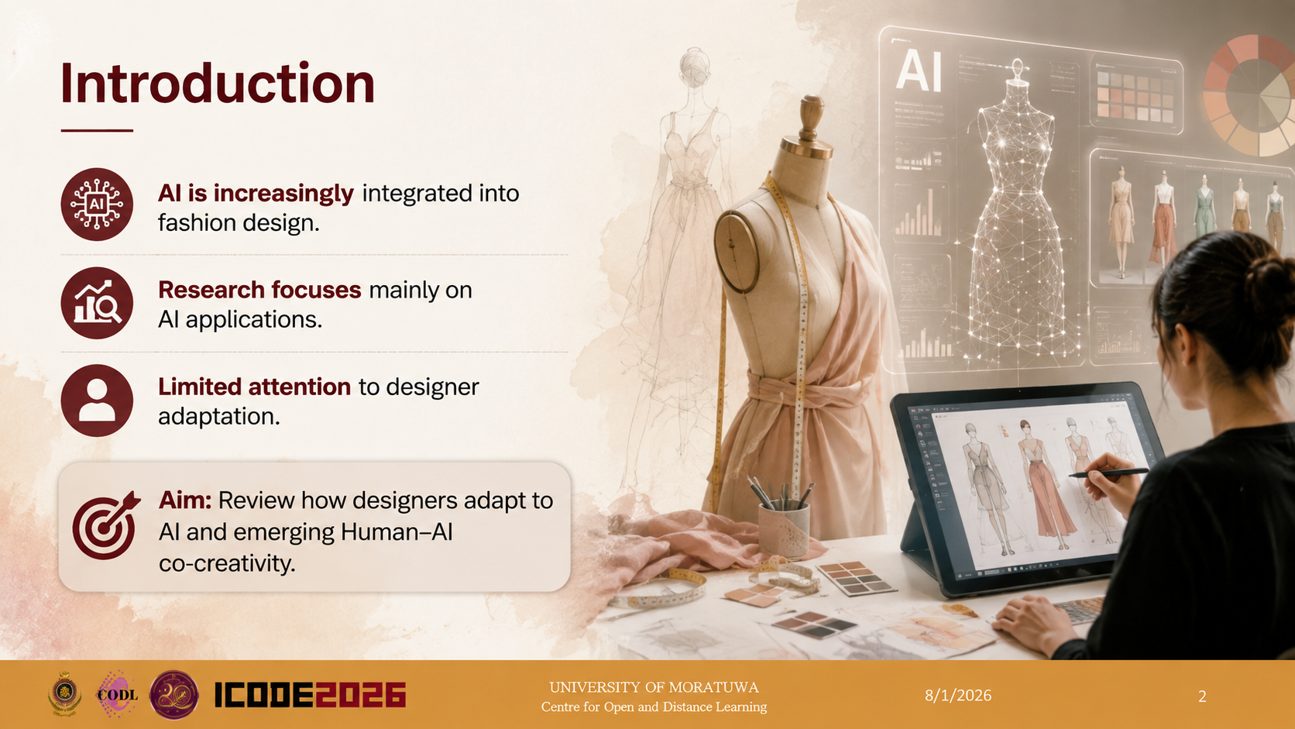

Slide 3
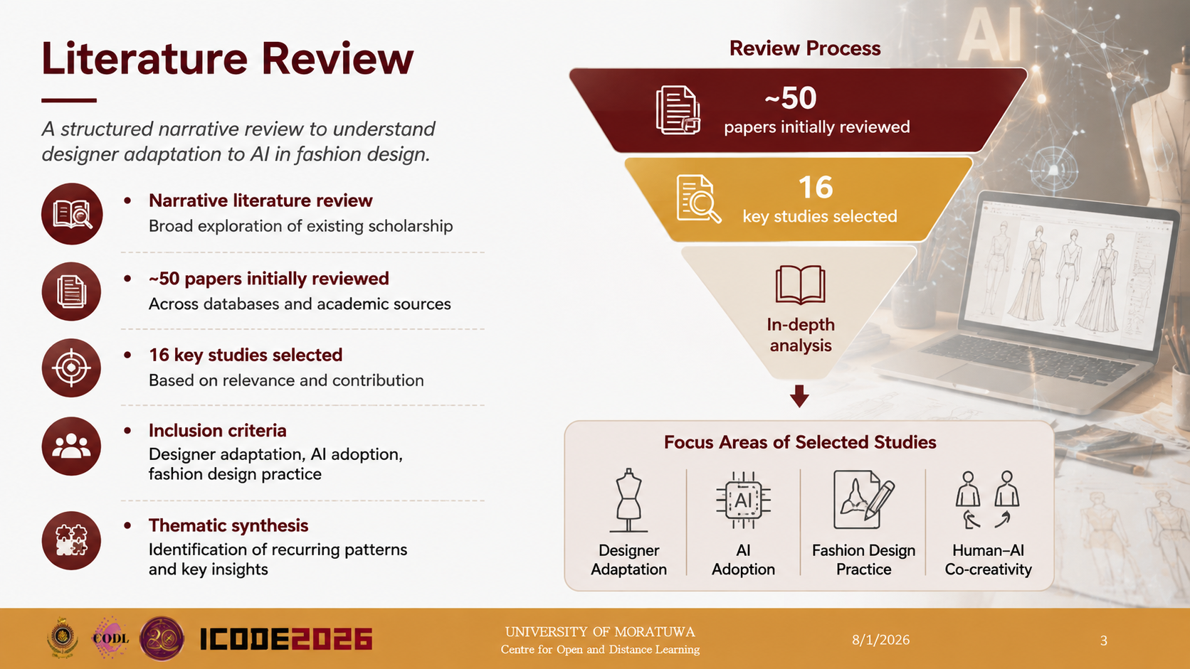

Slide 4
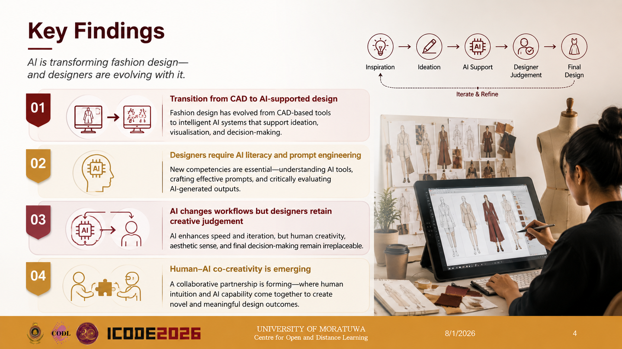

Slide 5
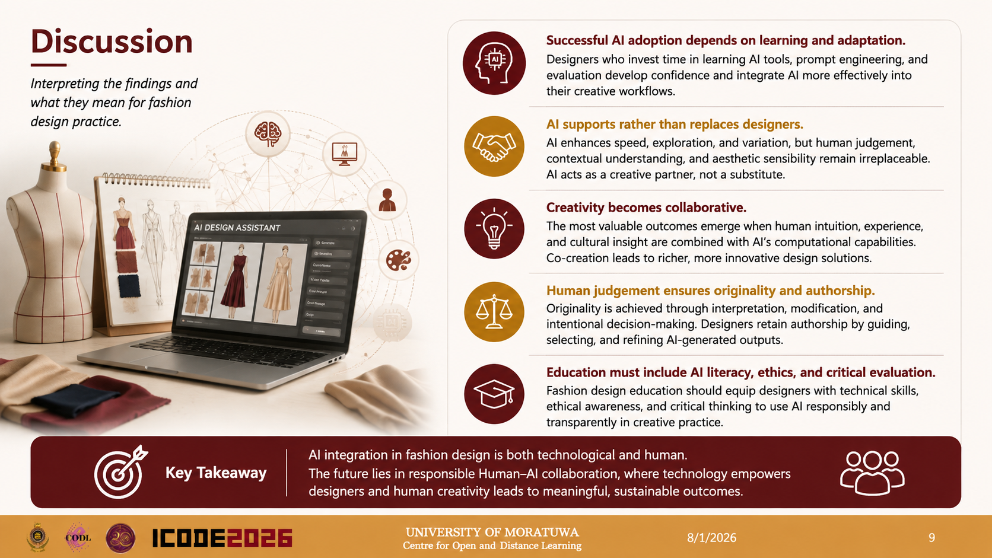

Slide 6
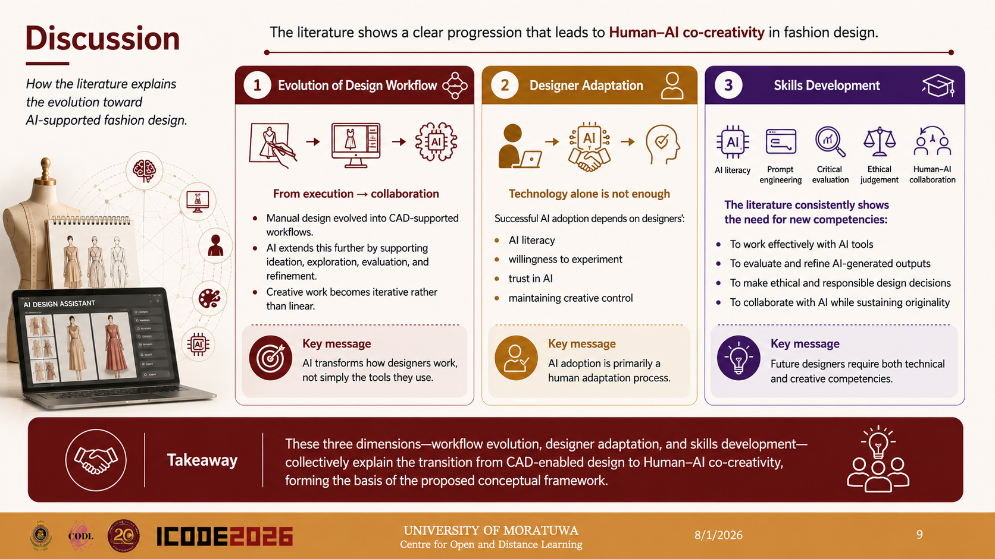

Slide 7
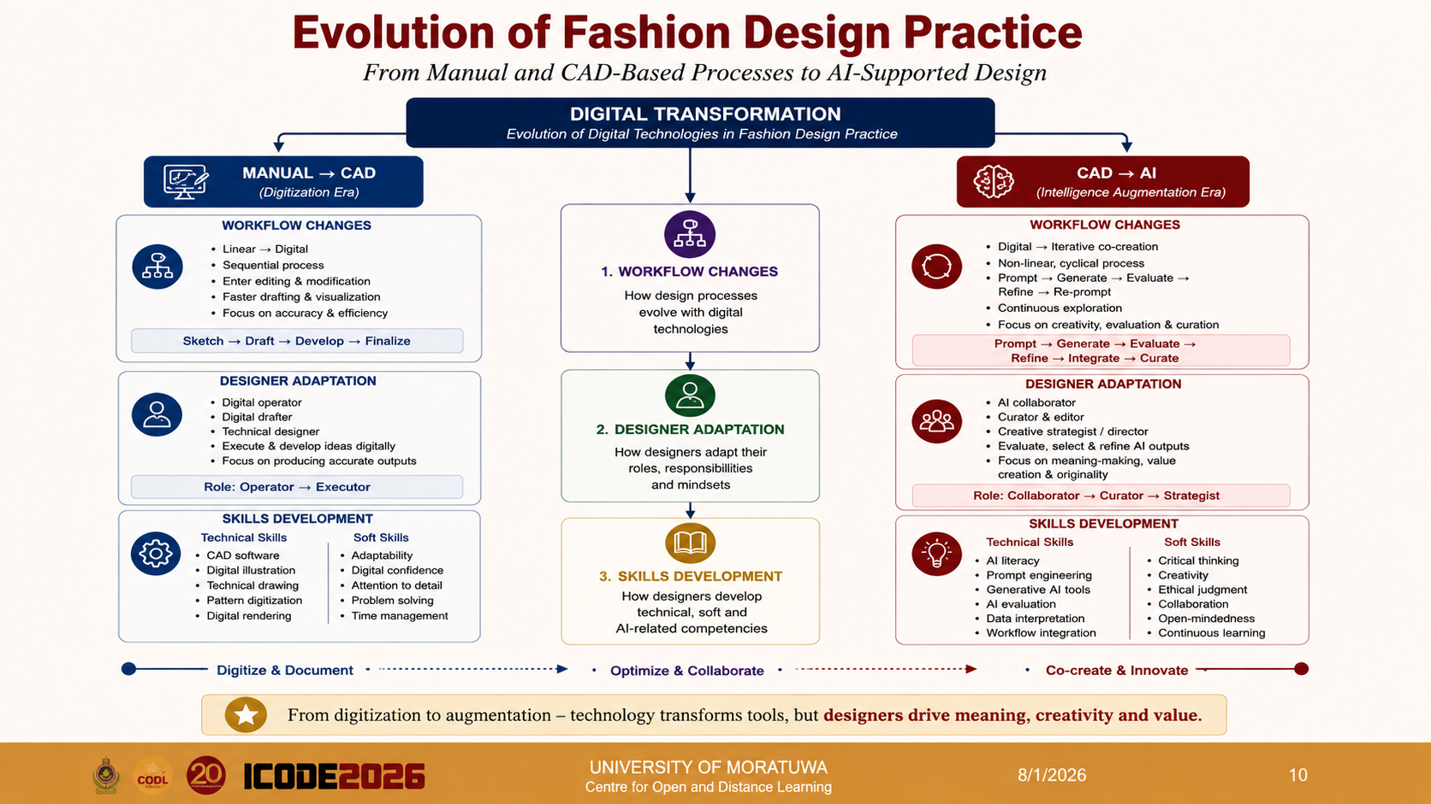

Slide 8
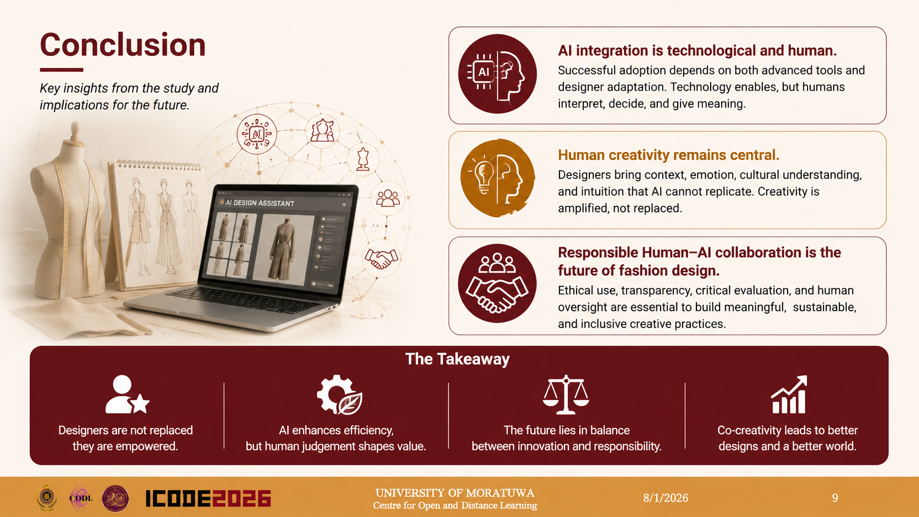

Slide 9
Thank you

